Slide 1
Market Analysis
Analyze Product Performance & Customer Purchasing Behavior

Slide 2
OVERVIEW
Project Objective & Approach
OBJECTIVE
METHODOLOGY
Analyze a large-scale grocery transaction dataset to understand which products and aisles drive volume and loyalty.
Profile customer ordering behavior — frequency, timing, and basket size — to surface retention opportunities.
Translate raw transactional data into decisions on inventory, promotions, and customer engagement.
Demonstrate an end-to-end analytics workflow: SQL-style querying, data modeling, and dashboarding.
20 SQL-style analytical questions answered across products, aisles, departments, and customer orders.
Data modeled in Power BI with custom DAX measures for reorder rate, order frequency, and basket metrics.
Two interactive dashboards built: Product Performance and Customer Purchasing Behavior.
Findings synthesized into the business insights and recommendations
02

Slide 3
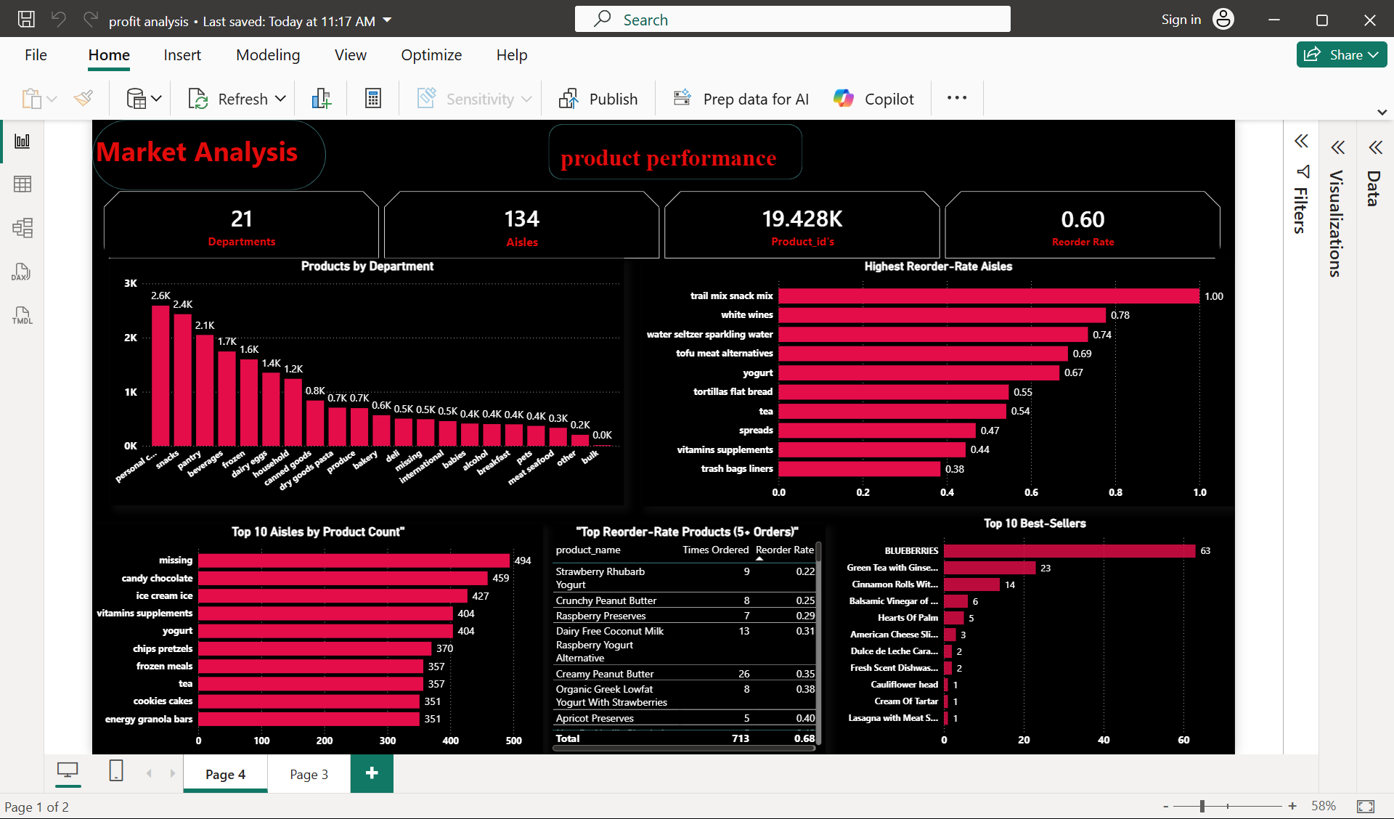
DASHBOARD 1
Power BI Dashboard: Product Performance
WHAT IT SHOWS
Personal care, snacks, and pantry are the largest departments by product count.
Trail mix, white wines, and sparkling water top the reorder-rate leaderboard.
Blueberries are by far the best-selling item, outpacing every other product.
04

Slide 4
Product Performance –KPI’S
21
Departments
134
Aisles
19.4K
Product-id’s
0.60
Overall reorder rate

Slide 5
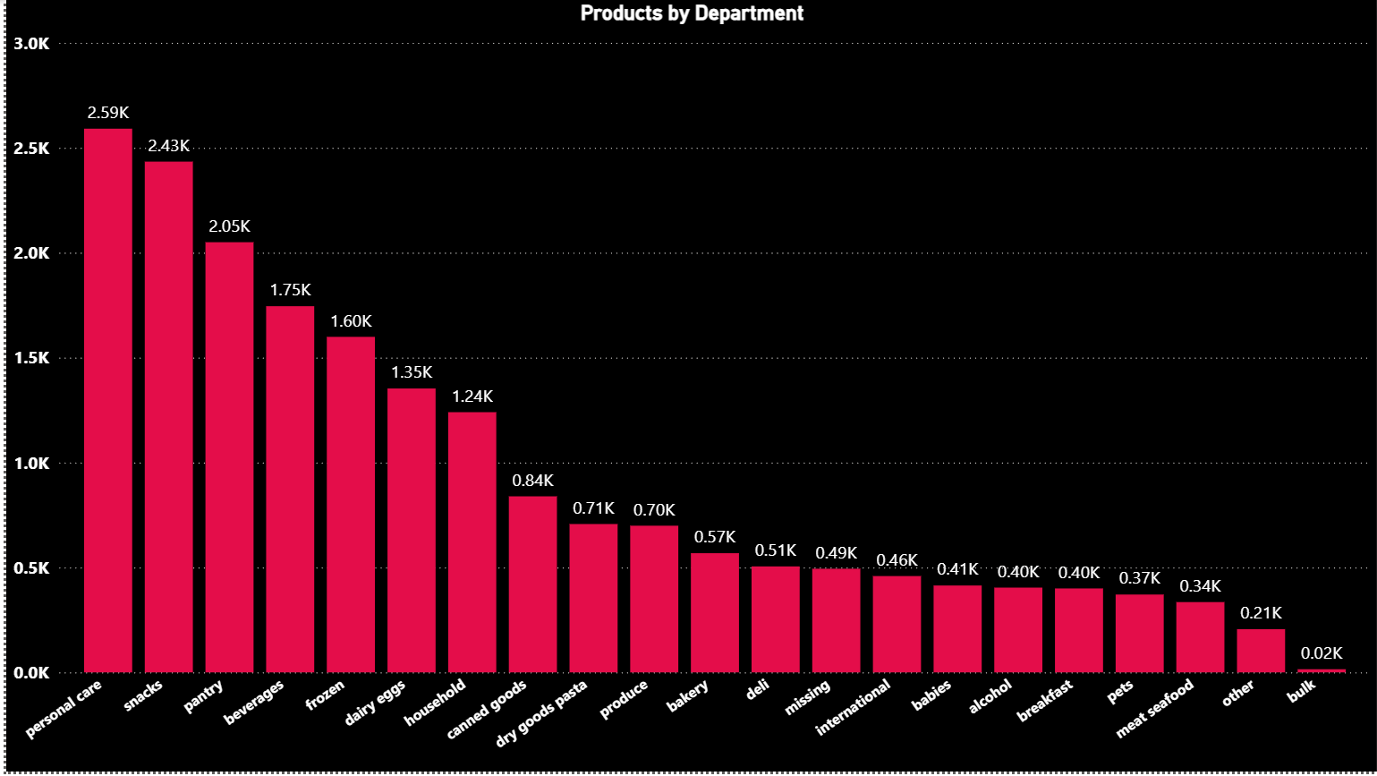
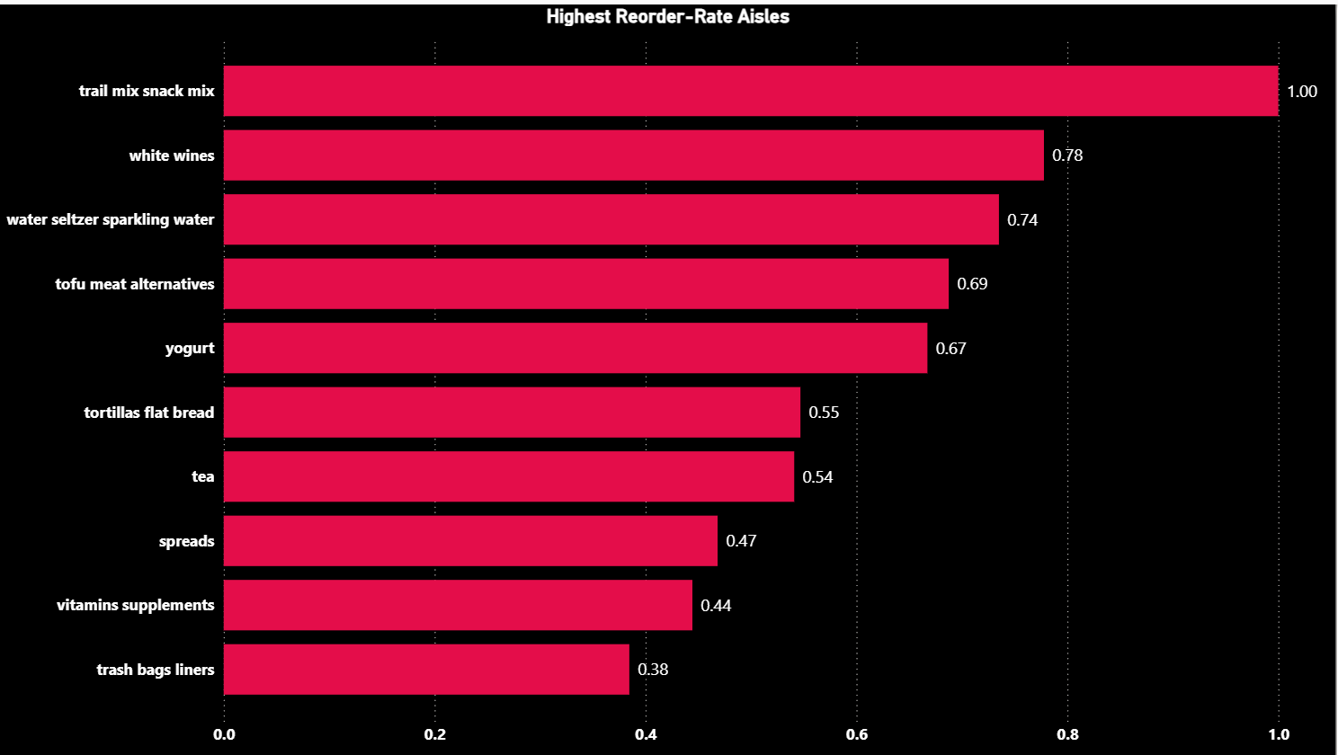
Product Department & Reorder Rate Analysis

Slide 6
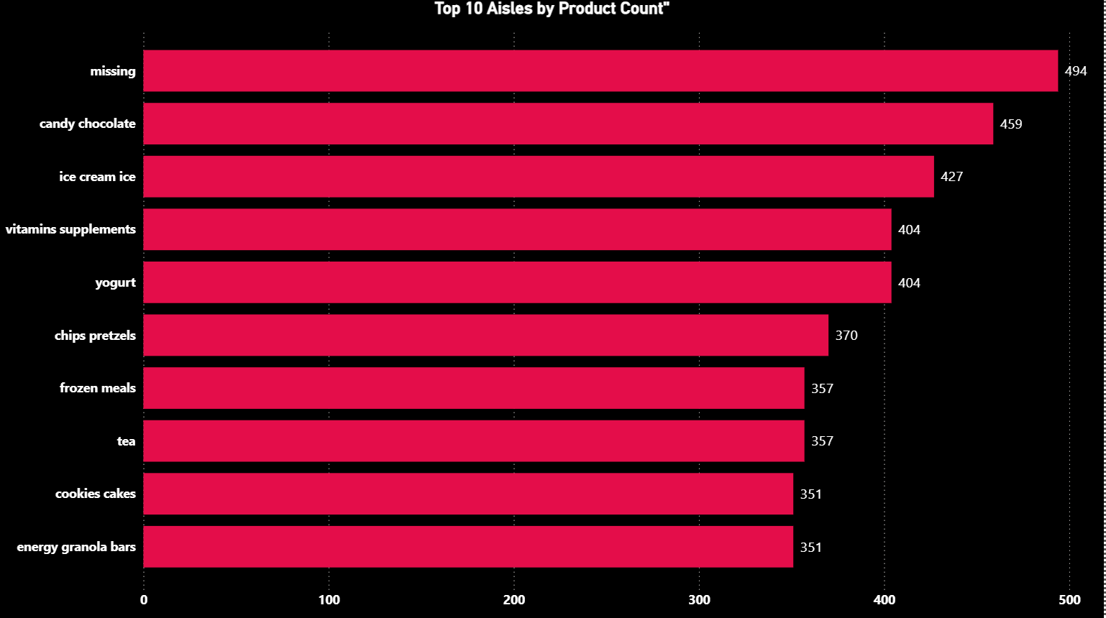
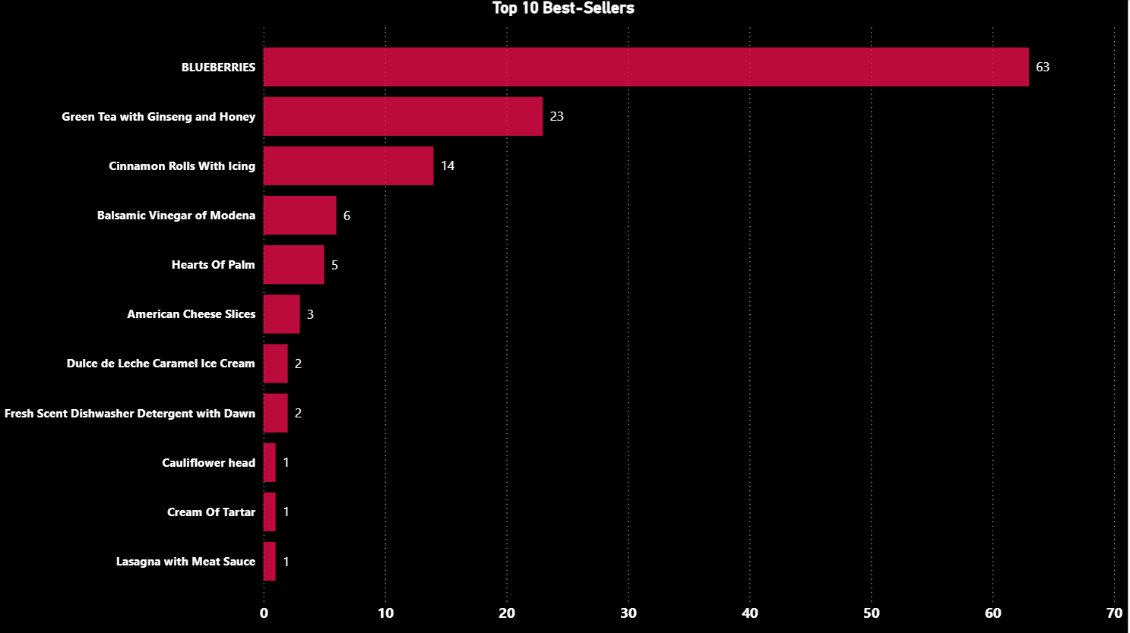
Top-Performing Aisles and Products

Slide 7
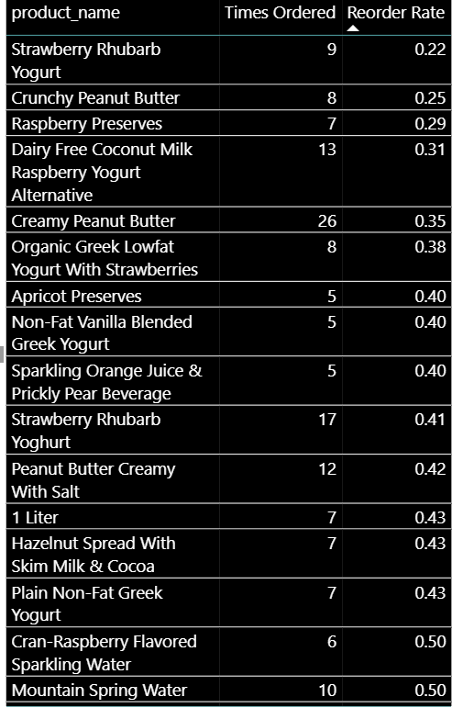
Top Reorder Rate Products(5*orders)

Slide 8
Dashboard 1: Product Performance
Insights
Personal care, snacks, and pantry account for ~7.1K of 19.4K products (~37%) — far more than other departments.
High-reorder aisles (trail mix 1.00, white wines 0.78, sparkling water 0.74, tofu alternatives 0.69, yogurt 0.67) are habitual, repeat-purchase items.
The overall reorder rate is 0.60, but this blended figure masks a large share of products with very low reorder rates.
"Missing" is the #1 ranked aisle by product count (494) — ahead of every legitimate category.
Best-sellers show a steep long tail: Blueberries lead with 63 orders, while most other listed items sit at just 1–2 orders.

Slide 9
Recommendations
Cross-check product count by department against actual order volume to confirm inventory isn't over-stocked in low-turnover categories.
Prioritize stock availability and loyalty/subscribe-and-save offers on high-reorder aisles — they're your retention drivers.
Cross-sell low-reorder, high-volume categories (candy/chocolate, ice cream) alongside high-reorder anchors like yogurt to lift their repeat rate.
Clean/impute the aisle mapping for "missing" entries before drawing further conclusions from the "Top 10 Aisles" chart.
Feature top 3 best-sellers in promo placement; flag bottom-of-list SKUs as discontinue/de-prioritize candidates.

Slide 10
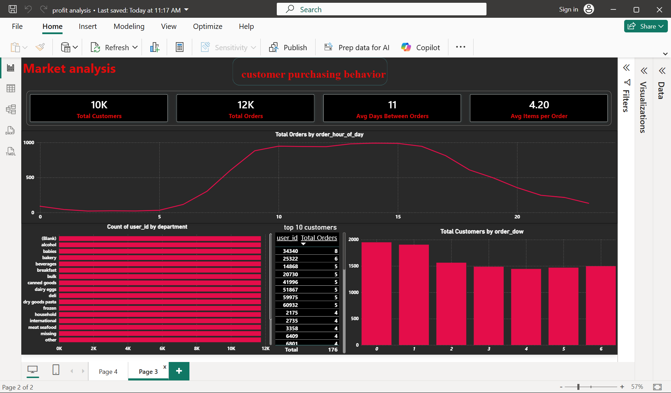
DASHBOARD 2
Power BI Dashboard: Customer Purchasing Behavior
WHAT IT SHOWS
~10K customers placed ~12K orders, averaging 11 days between orders and 4.2 items per order.
Ordering activity peaks in the late morning and stays high through early afternoon.
A small group of repeat customers (4-8 orders each) anchors order volume.
07

Slide 11
Customer Purchasing Behavior-kpi’s
10K
Total customers
12K
Total orders
11
Avg days between orders
4.20
Avg items per order

Slide 12
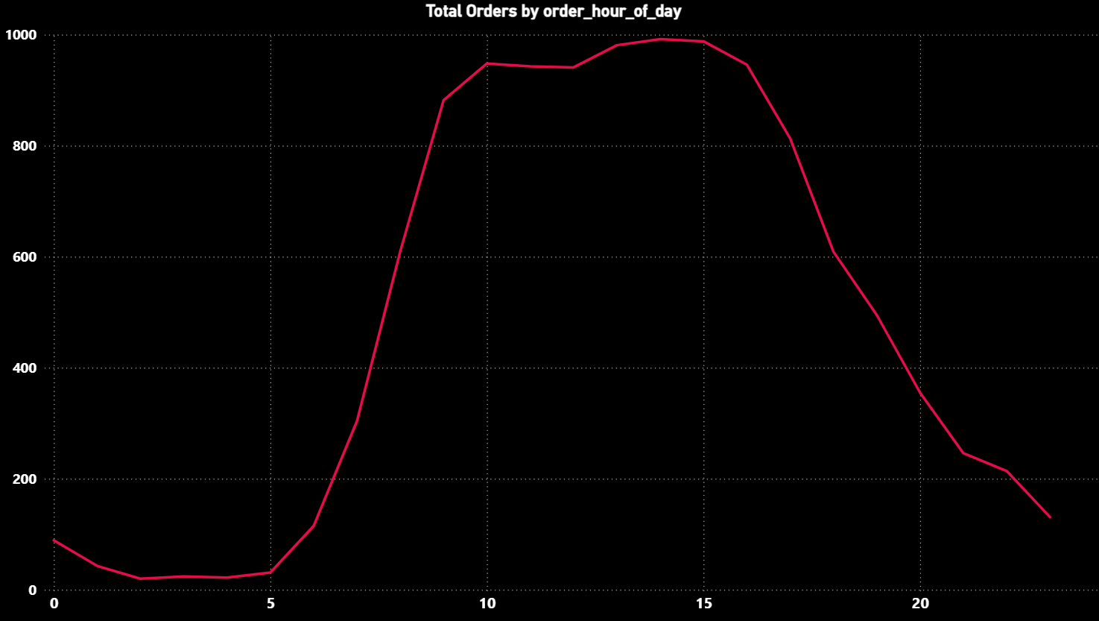
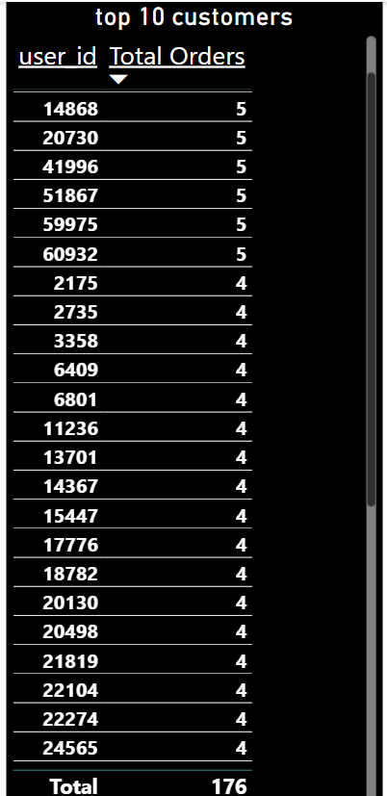
Customer Order Trends and Top Customers

Slide 13
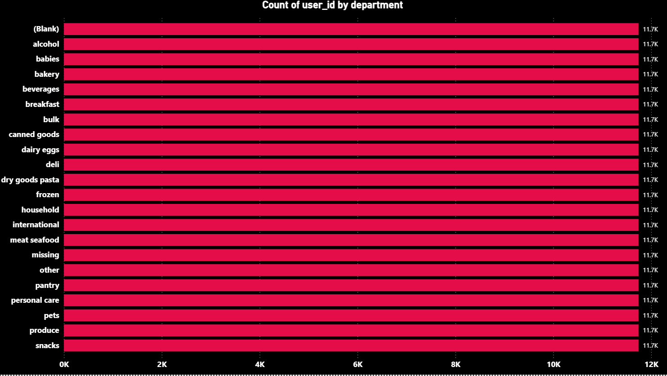
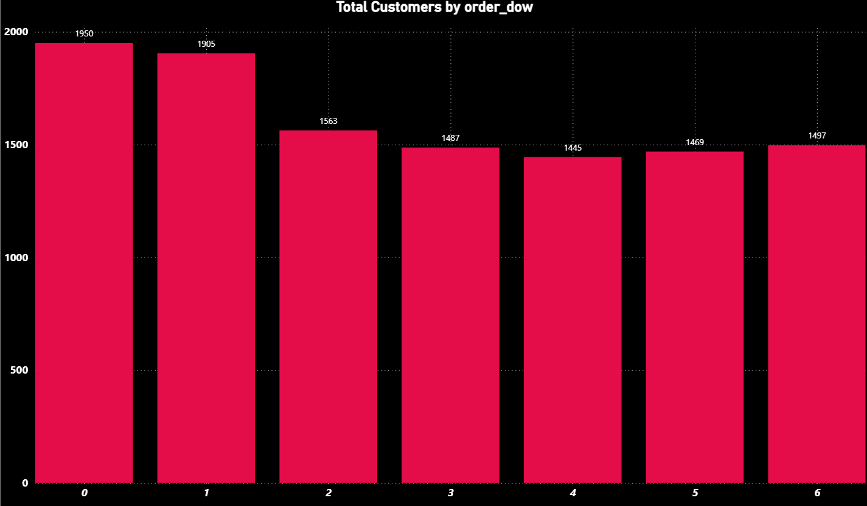
Customer Distribution and Weekly Order Analysis

Slide 14
Dashboard 2: Customer Purchasing Behaviour
Insights
Orders are near-zero from midnight–6 AM, ramp sharply 6–10 AM, plateau 10 AM–3 PM, then decline through the evening.
Day 0 and Day 1 customer counts (~1,900 and ~1,750) are well above days 2–6 (~1,300–1,450 each).
Average days between orders is 11, and top 10 customers place only 4–8 total orders each — shallow repeat-purchase depth.
Average items per order is just 4.20, despite a catalog spanning 134 aisles and ~19.4K products.
The "Count of user id by department" chart shows nearly identical bar lengths (~10–12K) across all departments, including a "(Blank)" category — indicating a likely measure/filter issue rather than real variation.

Slide 15
Recommendations
Concentrate push notifications, flash deals, and staffing/inventory readiness for the 8–10 AM window ahead of peak demand.
Run start-of-week promotions and targeted win-back campaigns for days 2–6 to flatten the weekly demand curve.
Launch a subscribe-and-save or auto-replenishment program anchored on high-reorder products to shorten the reorder cycle.
Add "frequently bought together" prompts and bundle discounts at checkout to lift basket size and order value.
Audit the underlying DAX measure/filter context for the department chart before using it for analysis — it's not currently reliable.

Slide 16
Thank you

